Slide 1
Do Greens Drive Hummers or Hybrids?
Environmental goods are to a large degree public goods – consumption is shared
The demand for environmental goods varies across people
Consumers can express their individual demand for environmental goods through
Advocating public policy
Private consumption choices

Slide 2
Demand curves D_{w} and D_{s} indicate variation in demand for environmental good
The increased willingness to pay for environmental good by D_{s} can be expressed by such action as:
Supporting laws that limit industrial production
Driving a Tesla or other EV
Supporting higher gasoline tax
Using public transportation
Convince people to purchase an EV
Which acts represent advocating public policy? Private demands?

Slide 3
In what way is altering private behavior to increase environmental quality irrational?
Rational?
It is possible that demanding an EV has nothing to do with environmentalism?
In which case D_{w} may be as likely to purchase hybrid as D_{s}

Slide 4
What would be the environmental motivation for D_{s} to, for example, buy a hybrid, or refuse to use plastic bags at the grocery?
People demanding environmental quality may gain private benefits from knowing that their private consumption behavior is consistent with public stances
Social pressure
Private behavior may aid political efforts (example: Greta Thunberg)

Slide 5
Do Greens Drive Hummers or Hybrids… estimates degree in which environmentalists private choices are in line with public advocacy
First must identify who environmentalists are
Takes advantage of observation that people who live near one another generally share characteristics

Slide 6
Paper uses the proportion of people in neighborhood who are registered in Green Party as indicator of neighborhood environmentalism
Proportion registered Green is low but varies greatly across neighborhoods
Other studies use questionnaire information

Slide 7
Paper first establishes that Green neighborhoods advocate environmental public policy
Estimates relationship between neighborhood share of Green party registrants and support for environmental referenda

Slide 8
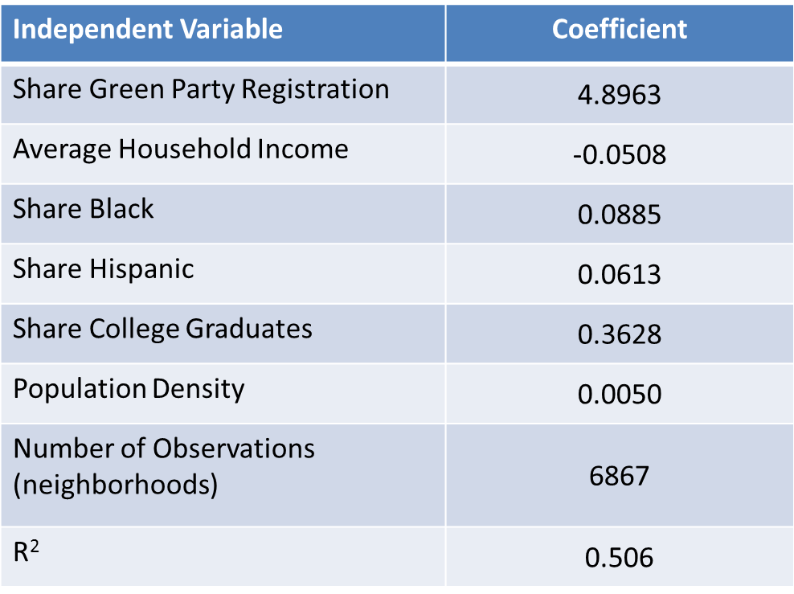
Proposition 185
% of yes votes by neighborhood = f(% green party, socioeconomic characteristics)

Slide 9
Proposition 185 imposes a 4 percent sales tax on gasoline, on top of the 18 cent per gallon state tax, and roughly 8% sales tax imposed by state on local governments.
Revenue will go toward constructing, maintaining mass transit.

Slide 10
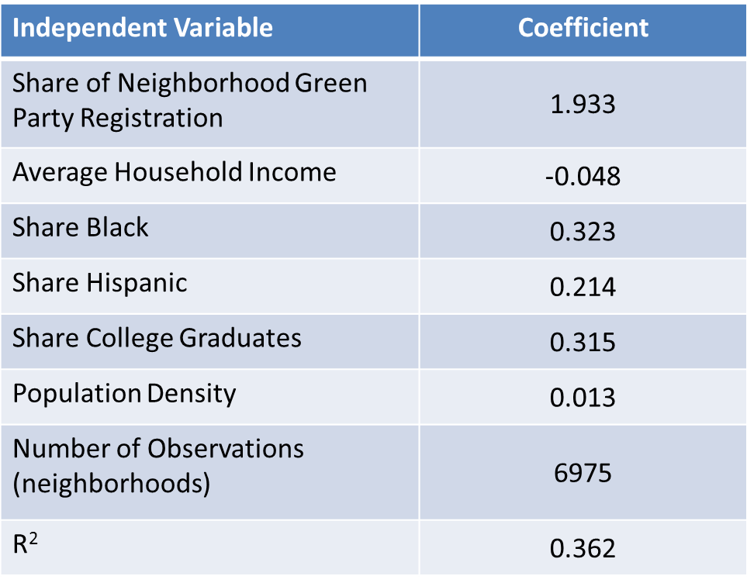
Proposition 13
% of yes votes by neighborhood = f(% green party, socioeconomic characteristics)

Slide 11
Proposition 13 called for the state to borrow 1.97 billion dollars (by issuing bonds) to spend on programs that would provide
Safe Drinking Water
Flood Protection
Watershed Protection
Clean Water and Water Recycling
Water Conservation
Water Supply, Reliability and Infrastructure

Slide 12
Does the evidence suggest residents in Green neighborhoods make private consumption choices that align with their public advocacy?
Study finds that neighborhoods within one mile of a rail transit station have a higher percentage of Green party registrants than otherwise
Are households in Green neighborhoods more likely to take public transportation than non-Green?

Slide 13
Factors determining the percentage of commuters (by neighborhood) who use public transportation
Independent Variable | Coefficient
Share of Neighborhood Green Party Registration | 1.34
Neighborhood within One Mile of Rail Station | 0.101
Average Household Income | -0.018
Share Black | 0.086
Share Hispanic | 0.075
Share College Graduates | 0.081
Population Density | 0.011
Mean Dependent Variable | 0.056
R² | 0.476

Slide 14
Do households in Green neighborhoods use less gasoline than equivalent households in other neighborhoods?
2001 National Household Transportation Survey asked individual households to estimate gasoline consumption

Slide 15
Factors determining the yearly gallons of gasoline consumed by individual households
Independent Variable | Coefficient
Share of Neighborhood Green Party Registration | -54.13*
Neighborhood within One Mile of Rail Station | -43.61
Neighborhood Density | -50.86
Average Household Income | 423.86
Household Size | 162.51
Mean Dependent Variable | 1062.26
Number of Households | 4678
R² | 0.22

