Slide 1
Climate Change
Stratosphere made up of gases that trap radiation (heat) from earth’s surface, causing it to be warmer than otherwise
Acts like greenhouse, sunlight let in but not all radiation let out
Natural effect that is vital to human life
Without greenhouse effect , earth’s average temperature would be roughly -18ºC (-0.4ºF); instead of its current +15ºC (59ºF)

Slide 2
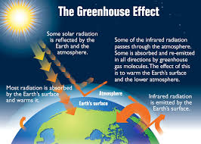

Slide 3
Carbon Dioxide is the most important gas in stratosphere generating greenhouse effect
CO₂ in the atmosphere has grown by 20% over the last 250 years
In the last 30 years alone it has grown 8%.

Slide 4
Greenhouse gases
Scientists link increase in greenhouse gases to human activity
Many human activities (such as exhaling) involve emission of greenhouse gases
Increase in greenhouse gases linked mainly to economic activity involving burning of fossil fuels

Slide 5
Examples of CO₂ emissions and burning of fossil fuels
Gasoline in cars
Coal in electric plants
Major Greenhouse Gases
GAS | Percent of Total
Carbon Dioxide (CO2) | 77
fossil fuels, deforestation, decay of biomass
Methane | 14
agriculture, landfills, termites
Nitrous Oxide | 8
fertilizer, industry, waste incineration
Other | 1

Slide 6
Increasing greenhouse gases are related to an estimated warming of the earth of 0.3 degrees (celsius) per decade.
This is much greater than estimated rate of change during previous periods of warming and cooling 0.05 degrees celsius

Slide 7
Effects Climate Change
Large uncertainty regarding effects
Effects anticipated to differ greatly across regions, countries
In general richer countries expected to be less effected then poorer
Wealthier countries are in cooler climate areas, and have more resources to use to adapt

Slide 8
Effects Climate Change (Damage)
Sea levels expected to rise due to melting ice in polar regions
Coastal regions forced to adapt
Island Nation
Flooding
Changes in agriculture; rising temperature may change location of crops
Many poor countries largely dependent on agriculture
Effects expected to be negative but actual changes are unknown
Changes in ocean current

Slide 9
Cost of Climate Change
Extremely difficult to put dollar value on damage from marginal ton of CO₂ emitted
Effect of CO₂ takes on a time dimension
Effect of warming caused by emissions will be felt mainly by future generations
Future generations may arrive at solutions that will have made present actions less necessary

Slide 10
A country’s total CO₂ production =
Population × GDP/Pop × Energy/GDP × CO₂/Energy
GDP/Pop: Wealthier countries tend to produce more greenhouse gases
Consume more goods and services whose production/consumption generates CO₂
Energy/GDP Countries that produce/use energy as large proportion of GDP produce more greenhouse gases
People may commute great distances; or use a lot of resources to stay warm or cool

Slide 11
CO₂/Energy Countries that rely on certain energy technology will produce more CO₂
Reliance on coal for energy produces CO₂; reliance on nuclear produces less CO₂
2015 Emissions by Country

Slide 12
Climate Change
Equity and economic efficiency of proposed policies on CO2 emissions
Each country decrease emissions by equal proportion
Countries should adjust so that emissions per capita would be equalized
Countries should adjust such that emissions per dollar of GDP is equalized (each would be equally energy efficient)

Slide 13
Kyoto Protocol
1997 agreement provides targets for developed countries to reduce greenhouse emissions
Ratified and came into force in 2005
Under agreement many developing countries would not have to limit emissions

Slide 14
Kyoto Protocol
Agreement set targets that were to be met over the years 2008 to 2012
In 2012, an amendment to Kyoto was adopted (Doha Amendment) that set greenhouse gas targets through 2020
So far only 25 countries have agreed to abide by Doha
US did not sign onto Kyoto protocol or its amendment

Slide 15
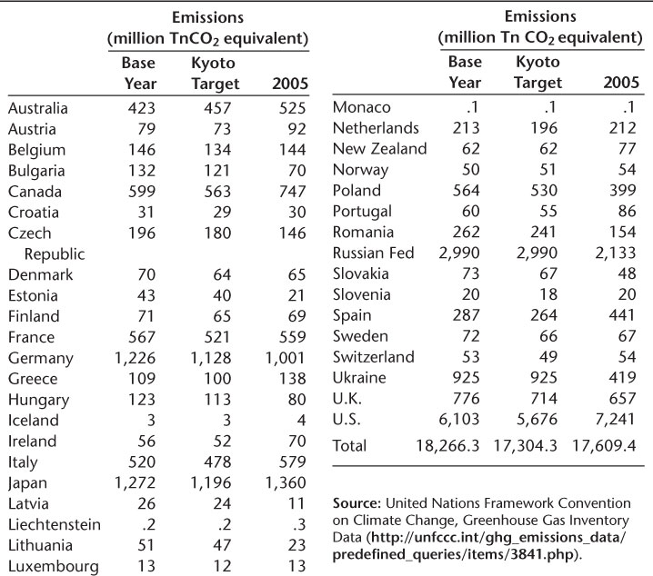

Slide 16
Montreal Protocol and Climate Change
Protocol called for elimination of products using mainly CFC’s that contributed to thinning of ozone layer
There is a provision in the protocol anticipating future environmental problems caused by substitutes for CFC’s
Many countries switched from CFC’s to hydrofluorocarbons, or HFCs, used in air-conditioners and refrigerators.

Slide 17
Montreal Protocol and Climate Change
HFC’s turned out to be a greenhouse gas
HFC’s are a small percentage of greenhouse gases but have 1000 times the heat-trapping potency of carbon dioxide
The provision in Montreal Protocol allowed amendments to treaty without every country re-ratifying treaty

Slide 18
Montreal Protocol and Climate Change
The negotiated amendment to Montreal is expected to lead to the reduction over time of the equivalent of 70 billion tons of carbon dioxide from the atmosphere
Roughly two times the carbon pollution produced annually by the entire world
Richer countries will eliminate HFC’s more quickly than poorer countries

Slide 19
Montreal Protocol and Climate Change
The amendment to the Montreal Protocol was worked out in October 2016 after seven years of negotiation
The amendment required the ratification from only twenty countries to come into effect, which it attained in November 2017
The amendment was not ratified by the US although it is was instrumental in negotiating the agreement
The US is subject to the amendment

Slide 20
Paris Accord on Climate Change
International agreement binding all countries to decrease greenhouse gases, including poor nations
Accord calls for some subsidy by rich countries to developing countries
Each of 186 countries required to put forth individual plan to cut greenhouse emissions
The specifics of each country’s plan are voluntary

Slide 21
Paris Accord on Climate Change
Accord projected to slow increase in world average temperature to 1.5 degrees Celsius by year 2100
Countries legally required to meet every five years to detail changes in plans
Requirement to publicly monitor and update plans used as way to induce countries to follow through

Slide 22
Paris Accord on Climate Change
The Accord went into effect in November 2016 when the required number of countries had ratified it
The US plan pledged to cut within 10 years greenhouse emissions by roughly 26% of the country’s 2005 level
Trump administration has withdrawn US from Paris Accords

