Slide 1
Health Care
Health care normally considered a good that is different from most others
Consumption of health care by many individuals is only occasional but may be extremely expensive
Concept of consumer choice on whether to acquire health care is less relevant in life/death circumstances
Health care also may have substantial positive externalities

Slide 2
Insurance and Health Care
Why does insurance in some form finance health care consumption for most people in advanced countries?
Insurance lowers risk
Allows the insured not to suffer large variation in consumption year to year (consumption smoothing)

Slide 3
Insurance Status in 2016 | Percent of US population
With Health Insurance | 90%
Private Insurance | 55%
Employer Based | 49%
Purchased Individually | 6%
Government Provided Insurance | 34%
Medicare | 13%
Medicaid | 19%
Other Public | 2%
Without Health Insurance | 10%

Slide 4
Health Insurance
Two fundamental problems with health insurance
Moral hazard reflects the change in behavior in people brought about by being insured
Adverse Selection reflects the additional cost to insurers brought about by the non-random self-selection of people into the pool of the insured

Slide 5
Private Insurance
How do Private insurance companies deal with Moral Hazard?
Insurance lowers the marginal cost of the decision to consume health care inducing moral hazard
Most private health plans include a yearly deductible the consumer pays before any payments are made by the insurance company (with exceptions)
Many plans also include coinsurance or copayment schedules in which the insured pays part of health costs beyond deductible

Slide 6
Market for non-emergency health care
With no insurance, equilibrium is at point e with a 1000 doctor visits per time period
With insurance covering 80% of costs, quantity demanded doubles from 1000 to 2000 visits
If health insurance covered 100% the quantity demanded would be 2250 visits
How elastic is the demand curve?
Price
(per visit)
500
e
S
100
D
1000
2000
2250
Number of visits

Slide 7
Adverse Selection
Adverse selection causes non-group based insurance to be very expensive
Example of 1000 individuals in market for insurance
Suppose per capita health care expenditure is known to be $5000/year
If the insurance company offers a policy for $5000/year, self selection will cause policy to unravel
Company would respond by screening out those applicants the company anticipates would be costly to cover. This practice is now illegal.

Slide 8
Adverse Selection
The Adverse Selection problem is solved if the company could insure all 10,000 individuals at once
The premiums collected from low cost customers would subsidize the care of high cost
Group insurance through employers represent over 85% of private insurance in the US

Slide 9
The Uninsured
In 2016, approximately 28 million Americans lack health insurance
Represents 10.5 to 11% of the non-elderly population
Virtually all the uninsured are under the age of 65; the elderly are universally covered by Medicare
They are typically not among the poorest residents; the poorest are covered by Medicaid

Slide 10
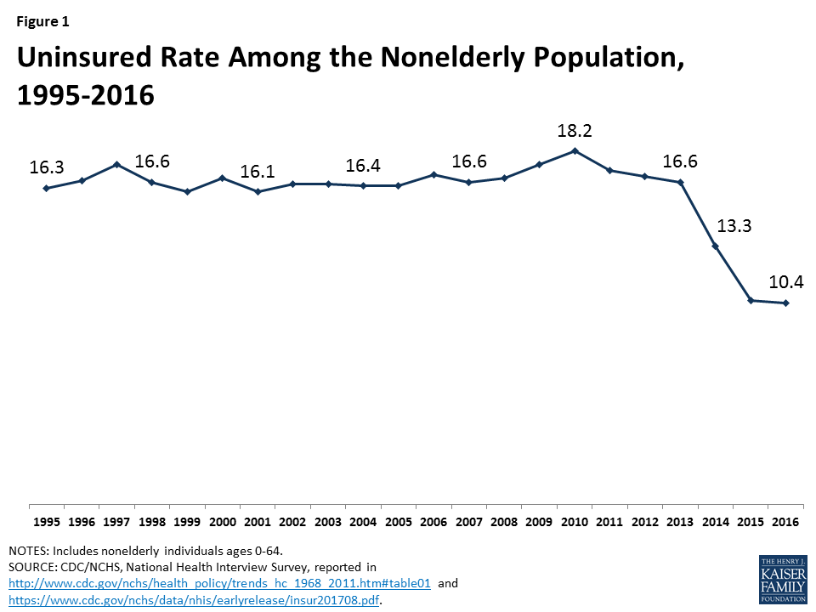

Slide 11
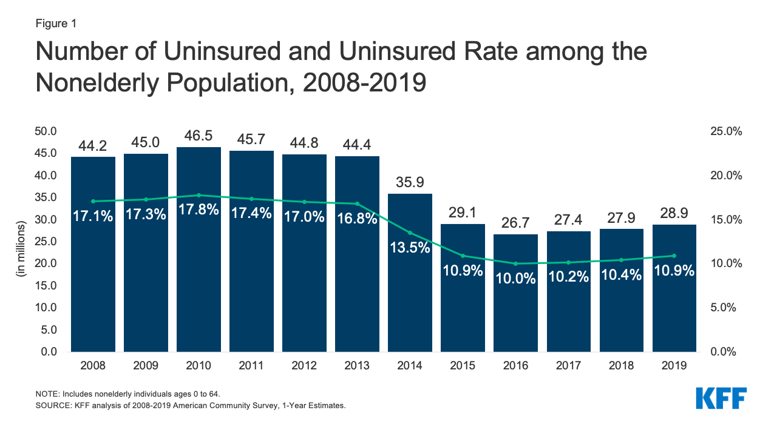
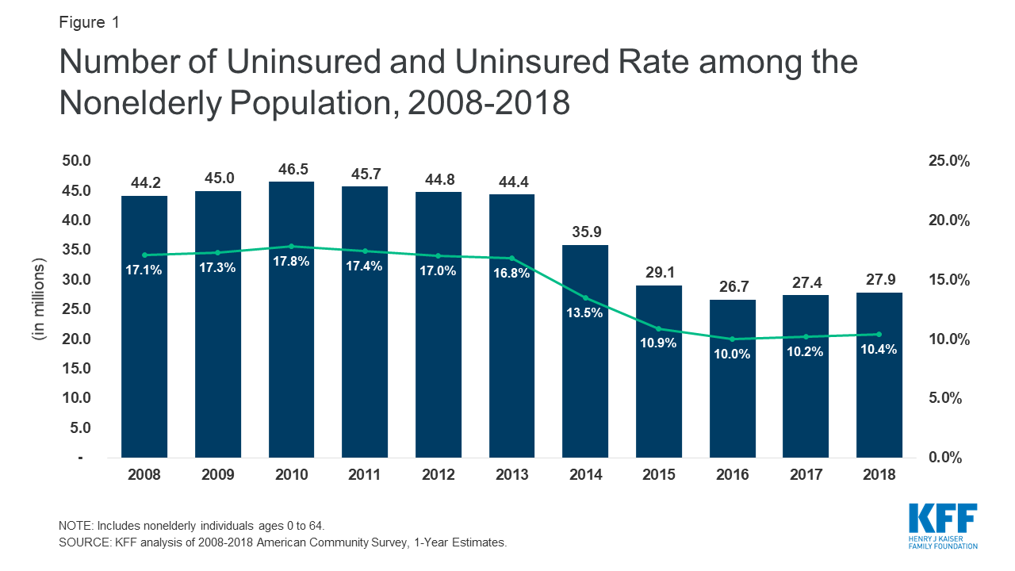

Slide 12
Uninsured by Age (2008)
Age | Percent uninsured
Under 18 | 9.9
18 to 24 | 28.6
25 to 34 | 26.5
35 to 44 | 19.4
45 to 64 | 14.4
65 years and older | 1.7

Slide 13
Uninsured by Age (2019)
Age | Percent uninsured
0 to 18 | 5.6
19 to 25 | 15.6
26 to 34 | 16.1
35 to 44 | 14
45 to 54 | 11.5
55 to 64 | 8.5

Slide 14
Uninsured by Age over Time
Year | 2000 | 2010 | 2012 | 2014 | 2016 | 2018
Under 18 years | 12.6 | 7.8 | 6.6 | 5.4 | 5.2 | 5.2
18-44 years | 22.4 | 27.1 | 24.8 | 19.7 | 14.8 | 15.4
45-64 years | 12.6 | 15.7 | 15.6 | 11.8 | 8.8 | 10.2

Slide 15
Characteristics of the non-elderly uninsured

Slide 16
Uninsured by Family Income (as of 2008)
Income | percent uninsured
less than $25,000 | 24.5
$25,000 to $49,999 | 21.4
$50,000 to $74,999 | 14
$75,000+ | 8.2

Slide 17
Uninsured by Family Income (as of 2014)
Income | percent uninsured
less than $25,000 | 16.6
$25,000 to $49,999 | 14.1
$50,000 to $74,999 | 10.7
$75,000 to $99,999 | 8
$100,000+ | 5.3

Slide 18
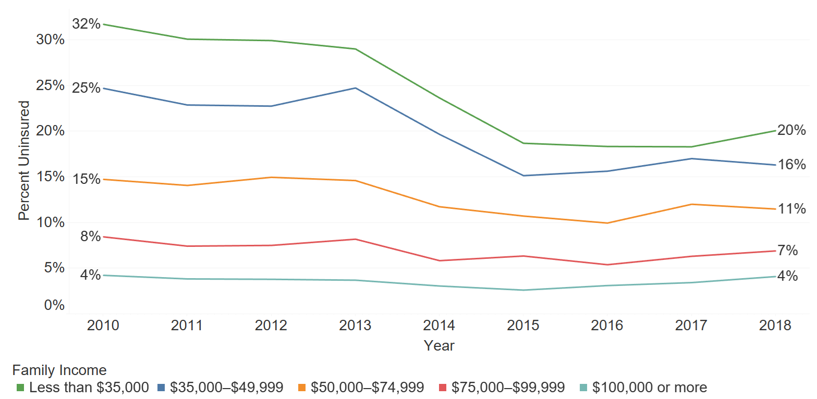
Percent of persons under age 65 who were uninsured at the time of interview by family income, 2010 – 2018

Slide 19
Changes in health care coverage induced by Covid 19

Slide 20
Health Care
Health care resources are scarce, must be rationed.
Why should non-market, collective decisions allocate health care?
Positive externalities of health care (examples)
Due to adverse selection, private market for health insurance may break down
Many people don’t support idea that scarce health care resources allocated solely on the basis of willingness (or ability) to pay

Slide 21
Health Care
The uninsured are subject to market conditions for health care
US fares poorly among wealthier nations in terms of deaths from treatable diseases
This is due partially to many people without insurance not seeking timely health care for problems

Slide 22
Characteristics of Health Care System in France
Insurance coverage is universal and obtained through employer
Employer (and employee) pay premium to one of fourteen regulated non-profit insurance funds that cover different segments of population
It’s illegal not to participate in your designated fund - government pays premium for unemployed

Slide 23
Characteristics of Health Care System in France
Insurance funds not allowed to deny coverage to anyone who falls under their purview
The funds are not allowed to challenge any bill sent by a doctor for service performed
The French are allowed to go to any doctor in the country

Slide 24
Characteristics of Health Care System in France
Cost control: government negotiates on behalf of insurance funds on prices of medical procedures with doctors’ unions
Through carte vitale there is little paperwork
Cost of procedures are in many cases a quarter of the cost in US

Slide 25
International Comparison of Health Care Costs
Statistics from U.S. Health Care from a Global Perspective, 2019

Slide 26
Why does the US pay so much for health care?
Total national expenditures = Procedures * Price per procedure
Example of prices
Price of diagnostic test
Many developed nations have explicit controls on prices of medical procedures, or negotiate prices Medicare’s drug policy

Slide 27
Why does the US pay so much for health care?
Private insurance firms have historically earned profits less by negotiating down the price of medical services, but through selection of consumers
Private/Public Insurance Cost Growth

Slide 28
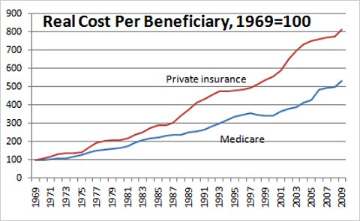

Slide 29
Why does the US pay so much for health care?
US is more prone to use expensive technology, sometimes as a marketing tool
Example of CT Scan
Magnetic Resonance Imaging machine (MRI)
Diagnostic technology that can create images within the entire human body
Each machine cost between 1 million and 2.5 million dollars
There are between 7,000 and 10,000 MRI machines in the US
As of 2007, Canada had 222

Slide 30
Patient Protection and Affordable Care Act
Goals:
Increase health insurance coverage
Slow the increasing cost of health care
Growth of health care expenditure relative to GDP

Slide 31
Patient Protection and Affordable Care Act
A. Mandates that insurance companies allow adult children to remain part of parent’s insurance coverage up to age 26 (in effect 2010)
Prohibits insurance companies from denying (due to pre-existing condition) children on adult insurance policies (2010)
Prohibits insurance companies from placing lifetime dollar limits on coverage (2010) or annual limits (2014)

Slide 32
Patient Protection and Affordable Care Act
Requires health insurers to spend at least 80% of income from premiums on health services (2011)
Expands Medicaid to cover everyone with incomes under 133% of the poverty line (2014). (Court ruling later allowed individual states allowed to opt out of expansion.)
California
Firms with more than 50 employees will be assessed a fee per employee if the employer does not offer health coverage (2014, delayed until 2015)

Slide 33
Patient Protection and Affordable Care Act
G. Mandate that every citizen must obtain insurance coverage (2014)
- defines what insurance coverage means
- lack of proof of coverage would result in a fine levied through income tax system (from $695 up to 2.5% of household income)
The mandate was repealed by 2017 Tax Cut Legislation
H. Subsidies for the purchase of insurance would be provided for families earning up to four times the federal poverty line

Slide 34
Patient Protection and Affordable Care Act
Insurance companies will no longer be allowed to use an adult applicant’s existing health condition in deciding on insuring the person (2014)
J. The pricing practice of insurance companies would be restricted:
Insurance companies could no longer set premiums for individual cases based on expected cost
Companies allowed to set single premium for broadly defined categories of customers

Slide 35
Patient Protection and Affordable Care Act
K. Establishes state based health exchanges (2014)
Run by either state agency or non-profit organization
Created for every state (20 states run their own exchange or are in partnership with federal government)
Health insurers (suppliers) in exchange must offer insurance packages satisfying minimum standards
L. Increases the Medicare payroll tax on earnings over $200,000 (2013)

Slide 36
Status of State Action on the Medicaid Expansion Decision

Slide 37
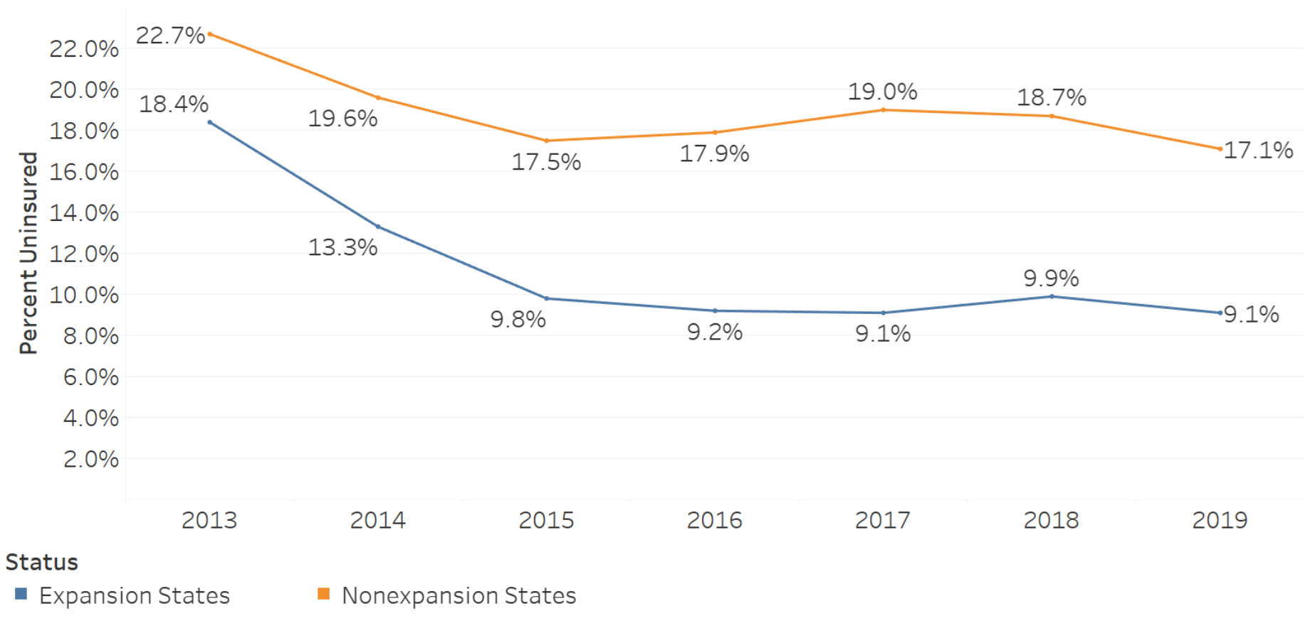
Percentage of adults aged 18–64 who were uninsured at the time of interview, by year and state Medicaid expansion status: United States, 2013–2019

Slide 38
ACA
Private insurance under ACA works through the healthy subsidizing the less healthy
Insurance companies suffer losses if, through adverse selection, few low cost customers purchase insurance relative to high cost
The ACA pulled healthier lower cost people into acquiring insurance through the health insurance subsidies
The ACA pushed healthier lower cost people into acquiring insurance through the system of fines that were part of the insurance mandate (this has been repealed)

Slide 39
ACA
The three ACA provisions, tying both insurers and the insured, work together:
Mandate that every adult indicate that he (she) and his (her) dependents have health insurance.
Insurance companies will no longer be allowed to use an applicant’s existing health condition in deciding on insuring the person.
Insurance companies will no longer be able to set premiums for individual cases based on expected cost. Insurance firms will be allowed to set single premiums only for broadly defined categories of customers.

Slide 40
ACA
As of 2019, households without health insurance during the year will no longer be subject to a fine when taxes are filed
The elimination of this push should contribute to adverse selection problem giving rise to higher premiums and fewer insured
The evidence suggests the elimination of the mandate has not led to a “Death Spiral”.
Partially due to intervention by individual states, the evidence this year suggests this has not happened.

Slide 41
ACA
The burden of the mandate fine by income level
Insurer participation across the US
Time trend in total enrollment in ACA marketplace

Slide 42
Possible changes to ACA
PUSH
PULL

